Slide 1
UNIX
Source Code Control system
Notes:
Add instructor notes here.

Slide 2
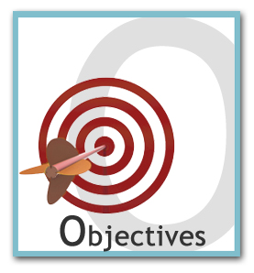
Lesson Objectives
SVN

Slide 3
9.1: SVN - Subversion What is SVN?
Subversion (SVN):
Software versioning and revision control system.
Tool that help in to control various program versions.
Only incremental changes to the program are stored. Multiple copies are not stored.
Particularly useful when programs are enhanced but the original version is still needed.
Notes:
A version control system (or revision control system) is a system that tracks incremental versions (or revisions) of files and, in some cases, directories over time. Of course, merely tracking the various versions of a user's (or group of users') files and directories isn't very interesting in itself. What makes a version control system useful is the fact that it allows user to explore the changes which resulted in each of those versions and facilitates the arbitrary recall of the same.
Explain advantage of SVN as a version control system. The concepts of version control has been already covered, just revised them.

Slide 4
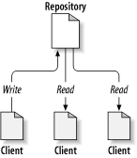
9.1: SVN - Subversion Repository
Repository is the central store of that system's data.
The repository usually stores information in the form of a file system tree ( a hierarchy of files and directories)
Any number of clients connect to the repository, and then read or write to these files.
A typical client/server
Notes:
At the core of the version control system is a repository, which is the central store of that system's data. The repository usually stores information in the form of a files system tree -- a hierarchy of files and directories. Any number of clients connect to the repository, and then read or write to these files. By writing data, a client makes the information available to others; by reading data, the client receives information from others.
What makes the repository special is that as the files in the repository are changed, the repository remembers each version of those files.
When a client reads data from the repository, it normally sees only the latest version of the files system tree. But what makes a version control client interesting is that it also has the ability to request previous states of the files system from the repository. A version control client can ask historical questions such as What did this directory contain last Wednesday? and Who was the last person to change this file, and what changes did he make? These are the sorts of questions that are at the heart of any version control system.
Note : Repository creation is a one time activity which happens on server and usually done by system administrator.

Slide 5
9.1: SVN - Subversion Initial Project Setup
If the project is not yet started , then create the basic directories required for project directly on repository.
If the project is already in place and the directory structure has been already defined then import the directory structure (along with the all latest files ) to the SVN repository.
After importing now delete local copy as files are now successfully stored in SVN repository.
Command for creating , Removing Directory and Checking log
svn mkdir file:///repository_path/directory_name -m “Message"
svn rm file:///repository_path/directory_name -m "Message"
svn log file:///repository_path
Notes:
Note : Initial Project Setup creation is a one time activity which can be done by administrator or user .
Following is the command to import the entire project from client to server
svn import user_directory_path file:///repository_path -m 'Message'

Slide 6
9.1: SVN - Checkout The Working Copy (Check-Out)
An ordinary directory tree on local system, containing a collection of files is called working copy.
Owner’s private work area ( edit , compile, change any files/code)
Complete Checkout
Partial Checkout
Changes in working copy needs explicit commit to update the changed version in repository
svn checkout file:///repository_path
svn checkout file:///repository_path/Directory_Path

Slide 7
9.1: SVN – Lock, Modify, Unlock The Problem of File-Sharing
The challenge is :
How we can make sure that only one person at a time should modify the file
Notes:
All version control systems have to solve the same fundamental problem: how will the system allow users to share information, but prevent them from accidentally stepping on each other's feet? It's all too easy for users to accidentally overwrite each other's changes in the repository.
Suppose we have two co-workers, Harry and Sally. They each decide to edit the same repository file at the same time. If Harry saves his changes to the repository first, then it's possible that (a few moments later) Sally could accidentally overwrite them with her own new version of the file. While Harry's version of the file won't be lost forever (because the system remembers every change), any changes Harry made won't be present in Sally's newer version of the file, because she never saw Harry's changes to begin with. Harry's work is still effectively lost or at least missing from the latest version of the file and probably by accident. This is definitely a situation we want to avoid!

Slide 8
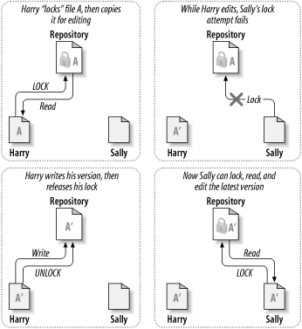
9.1: SVN – Lock, Modify, Unlock The lock-modify-unlock solution
Notes:
The Lock-Modify-Unlock Solution
Many version control systems use a lock-modify-unlock model to address the problem of many authors clobbering each other's work. In this model, the repository allows only one person to change a file at a time. This exclusivity policy is managed using locks. Harry must lock a file before he can begin making changes to it. If Harry has locked a file, then Sally cannot also lock it, and therefore cannot make any changes to that file. All she can do is read the file, and wait for Harry to finish his changes and release his lock. After Harry unlocks the file, Sally can take her turn by locking and editing the file.
The problem with the lock-modify-unlock model is that it's a bit restrictive, and often becomes a roadblock for users:
--Locking may cause administrative problems. Sometimes Harry will lock a file and then forget about it. Meanwhile, because Sally is still waiting to edit the file, her hands are tied.
--Locking may cause unnecessary serialization. What if Harry is editing the beginning of a text file, and Sally simply wants to edit the end of the same file? These changes don't overlap at all. They could easily edit the file simultaneously.
The solution of this problem is “Copy-Modify-Merge”

Slide 9
9.1: SVN – Few More Commands SVN-More Command
Addition of file to repository
Committing the changes
Locking the file
Un-Locking the file
svn add File_Path/File_Name File_Path/File_Name
svn commit -m ‘Message'
svn lock File_Path/File_Name File -m “Message"
svn unlock File_Path/File_Name

Slide 10

Summary
SVN

Slide 11

Review Questions
In _______ multiple copies are not stored only changes are stored.
List any 3 commands used in SVN?

Slide 12
Reference Books
The Unix Programming Environment
Kerningham & Pike, Prentice Hall
Unix System V.4 Concepts and Applications
Sumitabha Das, Tata McGraw-Hill
Advanced Unix Programmer’s Guide
Stephen Prata, BPB
Introducing Unix System V
Vijay Mukhi, Tata McGrawHill

